Slide 1
Conditional Probability
The probability of event A happening if event B has already happened is called the conditional probability of A given B, written as P(A|B).
P(A|B) = P(A and B)/P(B)
Two events are called Independent if P(A|B) = P(A), i.e., P(A and B) = P(A).P(B)
Bayes’ theorem: P(B|A) = (P(A|B)P(B))/P(A)

Slide 2
There are two competing companies X and Y. If X launches a product, there is a 60% chance that Y will launch a competing product. If Y is the first to launch a product, there is a 70% chance X will introduce a competing product. If the chances of X launching a product on its own is 75%, what is the chance of Y launching a product on its own?
P(Y|X)=0.6, P(X|Y)=0.7, P(X)=0.75
By Bayes’ theorem, P(Y|X)=P(X|Y)P(Y)/P(X), so P(Y)=0.6*0.75/0.7=0.643

Slide 3
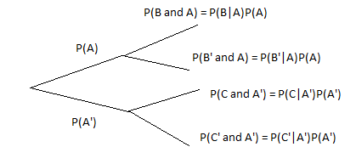
Decision trees

Slide 4
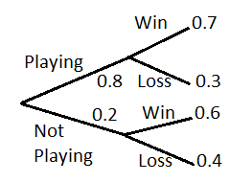
When Malinga plays for the Mumbai Indians the team has a 70% chance of victory. When he does not play, the chance of victory is 60%. Malinga has a 20% chance of not playing. If there are 16 matches in a season, how many matches is the team likely to win?
From the decision tree, P(Win)=0.7*0.8+0.6*0.2=0.68
Matches won = Matches played * P(Win) = 16 * 0.68=10.88

Slide 5
In a game, there are three doors. One door contains the prize, the others contain nothing. After the player makes a selection, one of the remaining doors which is empty is eliminated. At this point, the player may stick to his original choice or change to the remaining door. Which option has a better chance of winning?
Chance of selecting the correct door in the beginning is 1/3
A wrong door is eliminated.
Correct choice is to switch (1-1/3=2/3 chance of winning)

Slide 6
A company spends $50,000 developing a product. There is a 20% chance the product fails to develop correctly. Once developed the company must spend $20,000 testing for safety, and there is a 40% chance the product will fail the test. Once it passes the test, the company needs to spend $200,000 marketing the product. How much money does a product that reaches the marketing phase need to bring in for the company to break even?
Outcomes: 1st step failure, 0.2 chance, - 50k outcome
2nd step failure, 0.8*0.4 chance, - 70k outcome
2nd step success, 0.8*0.6 chance, Income x, expenses 270k
Thus, (x-270k)*0.8*0.6 – 70k*0.8*0.4 – 50k*0.2 = 0
Thus x=337,500

